Slide 1

Weather forecasting
Mounika Pulapalli
Sonika Meka

Slide 2

Contents
Objective
Dataset overview
Technologies
Approach
Environment Setup
Data Visualization
ML Model Training

Slide 3

OBJECTIVE
This project aims to forecast predictive analysis using descriptive analysis for predicting various weather parameters, such as snowfall, fog, and cold. This project will design and implement a machine learning-driven weather forecasting system that harnesses big data analytics.

Slide 4
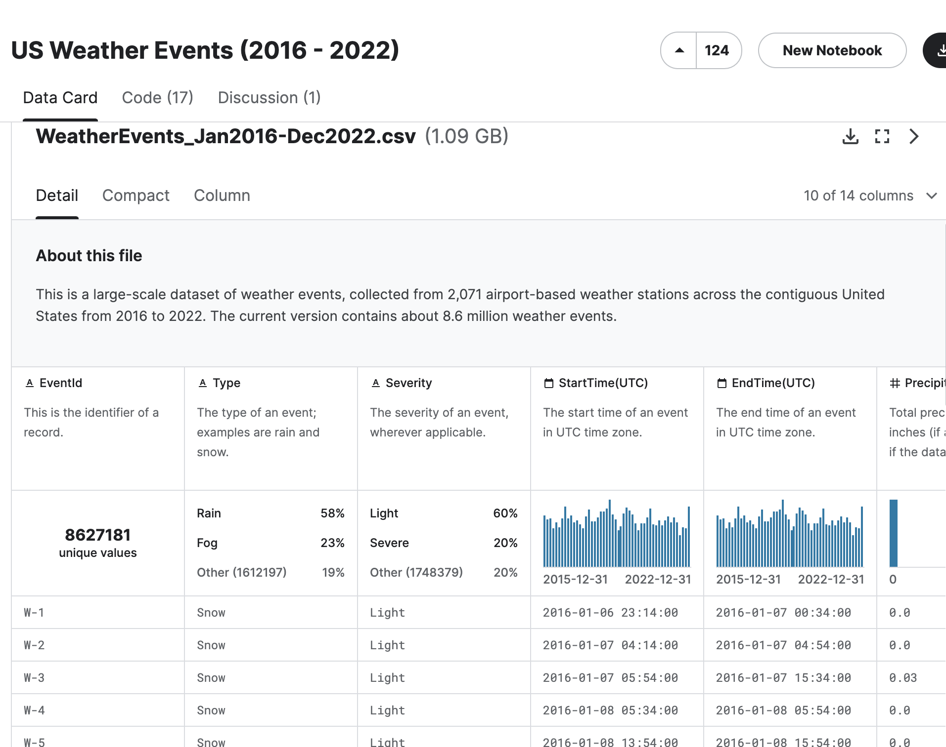
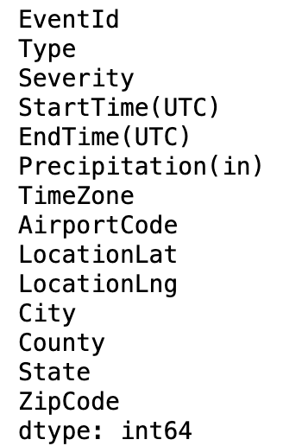
Source of Dataset
https://www.kaggle.com/datasets/sobhanmoosavi/us-weather-events/data

Slide 5
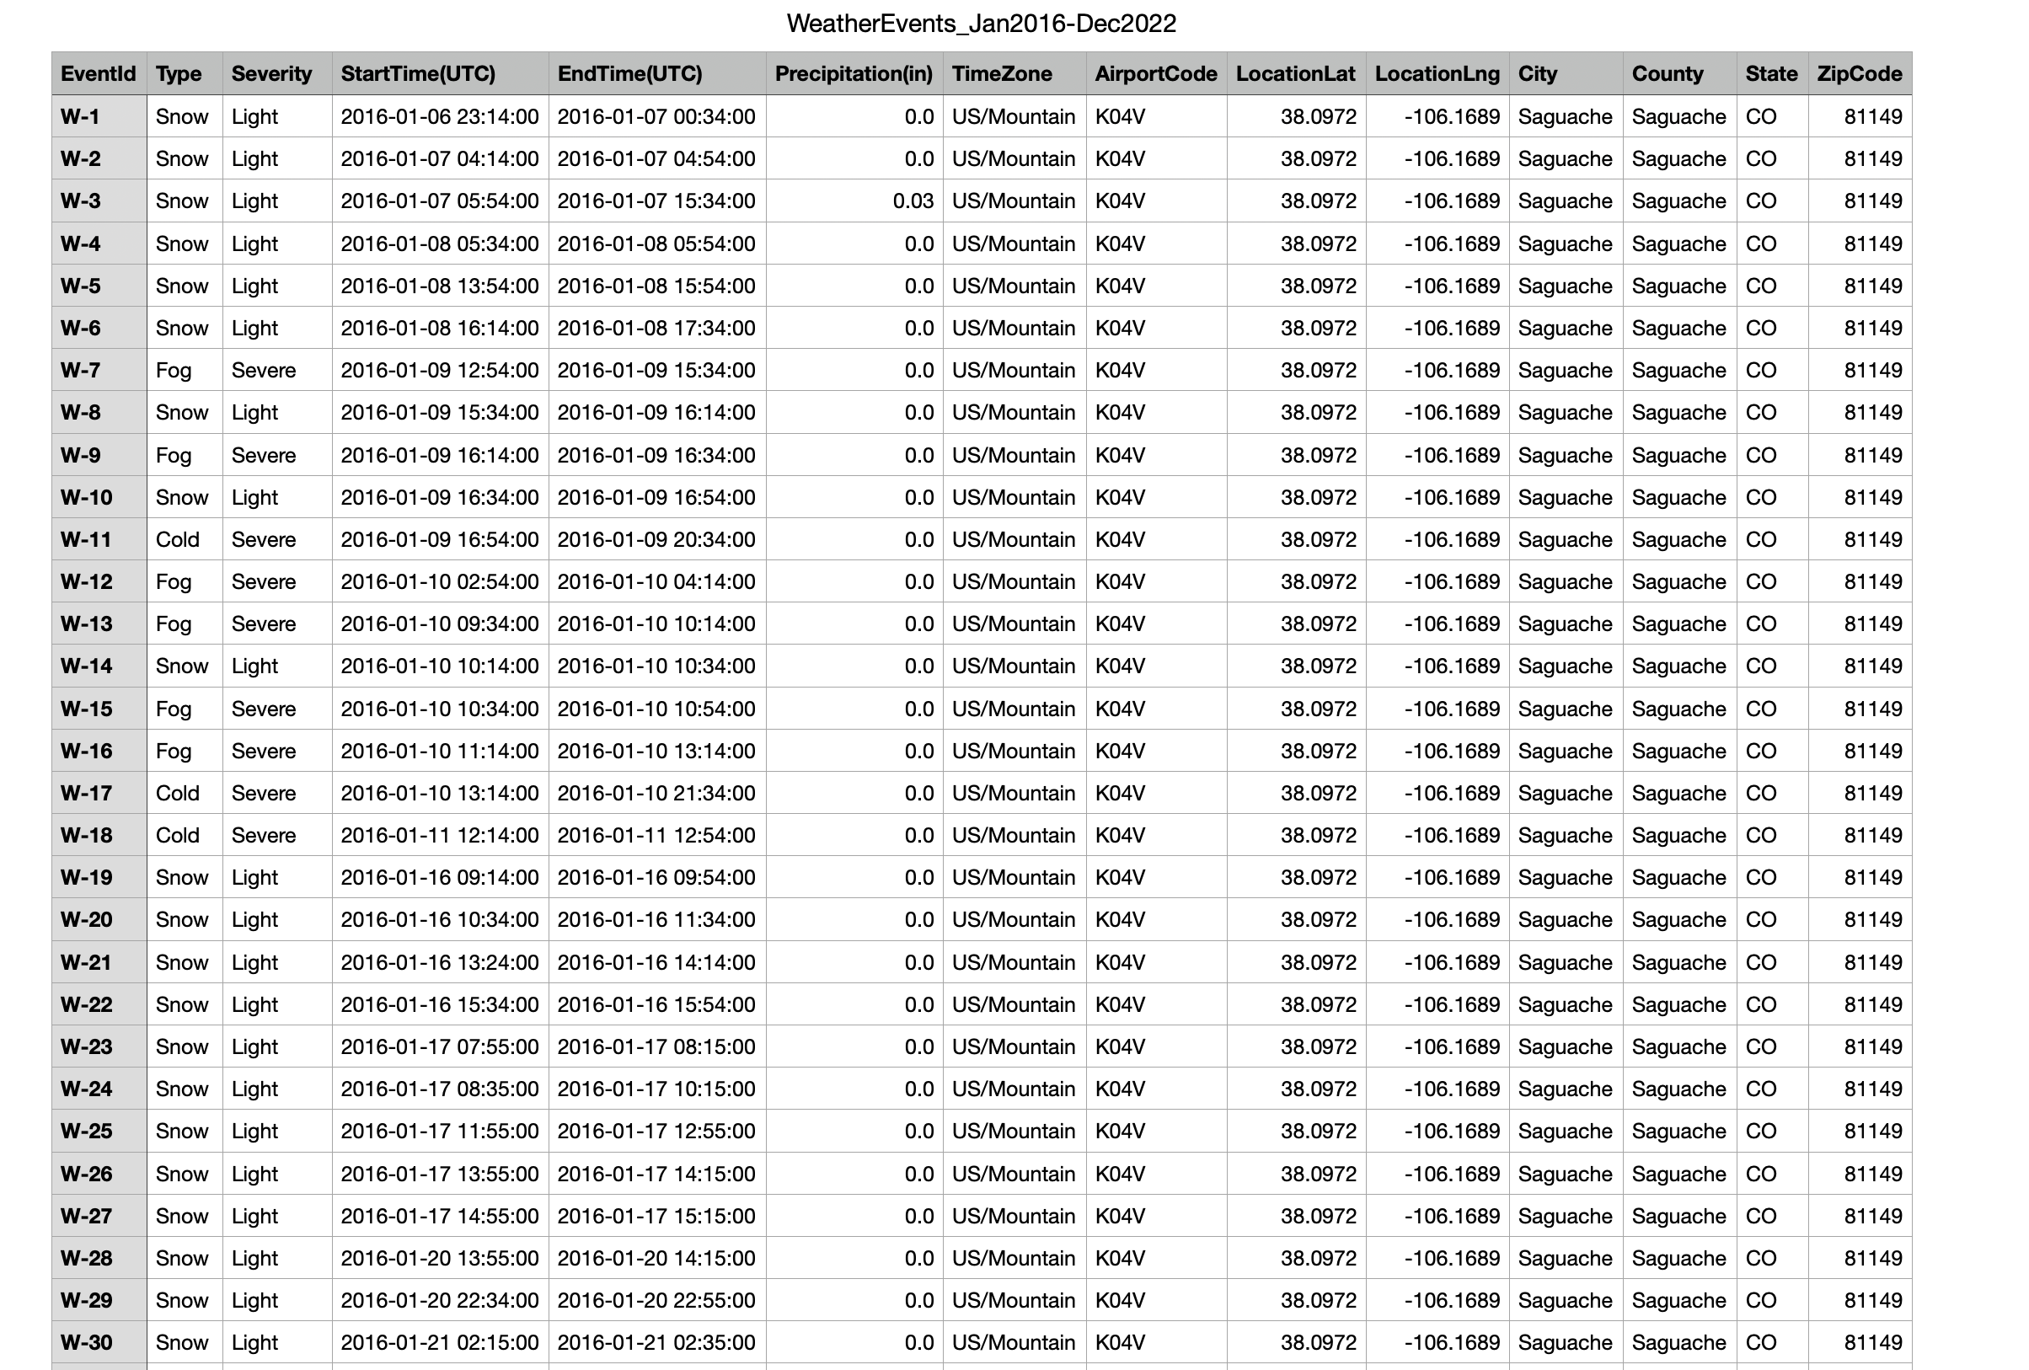
DATASET OVERVIEW

Slide 6
Technologies
AWS (Amazon web services)
AWS EMR
Hadoop
AWS S3
Apache Spark
Jupyter Notebook

Slide 7
Approach
Our project relies on AWS infrastructure, utilizing AWS S3 to store the dataset.
AWS EMR is employed to construct the Hadoop framework.
Apache PySpark serves multiple functions within the project:
a. For data cleaning
b. Facilitating data visualization
c. Executing model training and predictions.
The comprehensive data analysis takes place within Jupyter Notebook.

Slide 8

Setting up the Environment for the project – Weather Forecasting

Slide 9
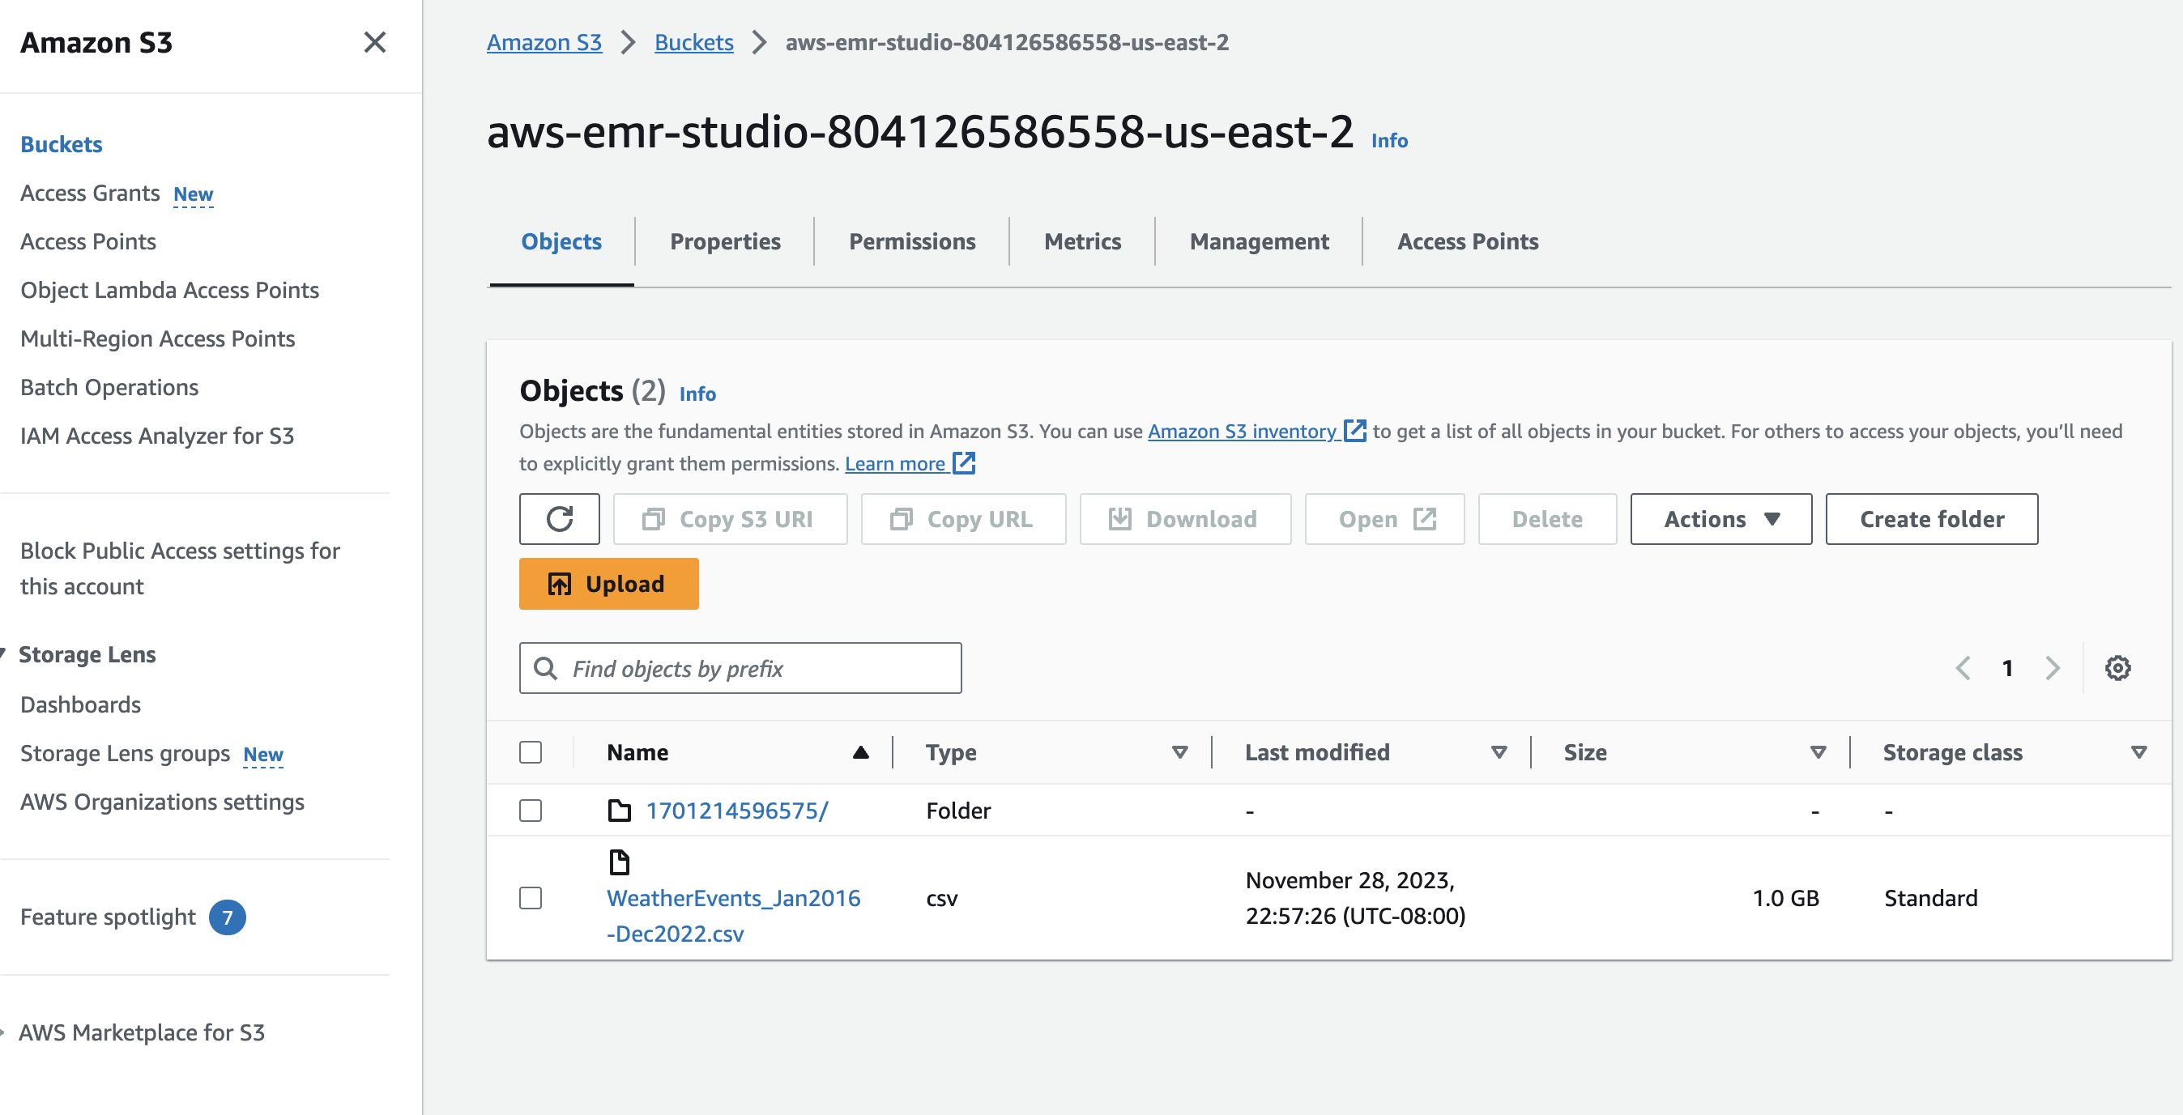
Storage AWS S3

Slide 10
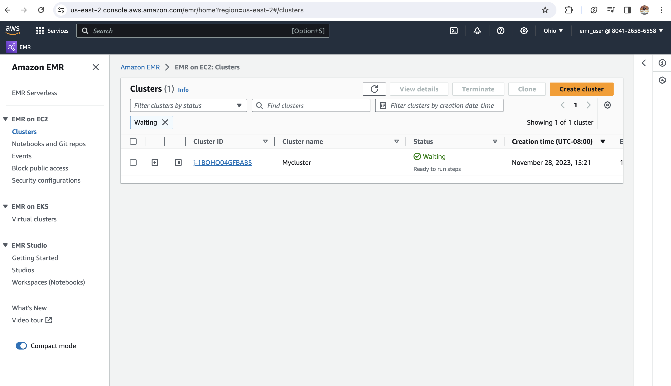
Hadoop Cluster

Slide 11
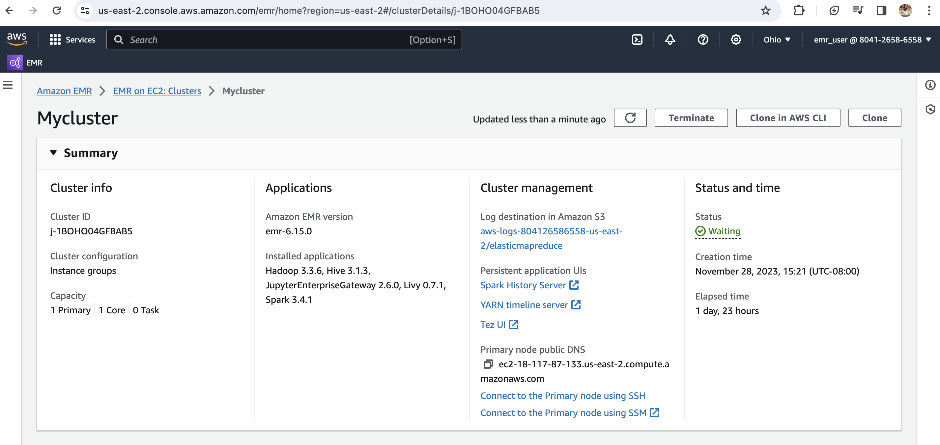
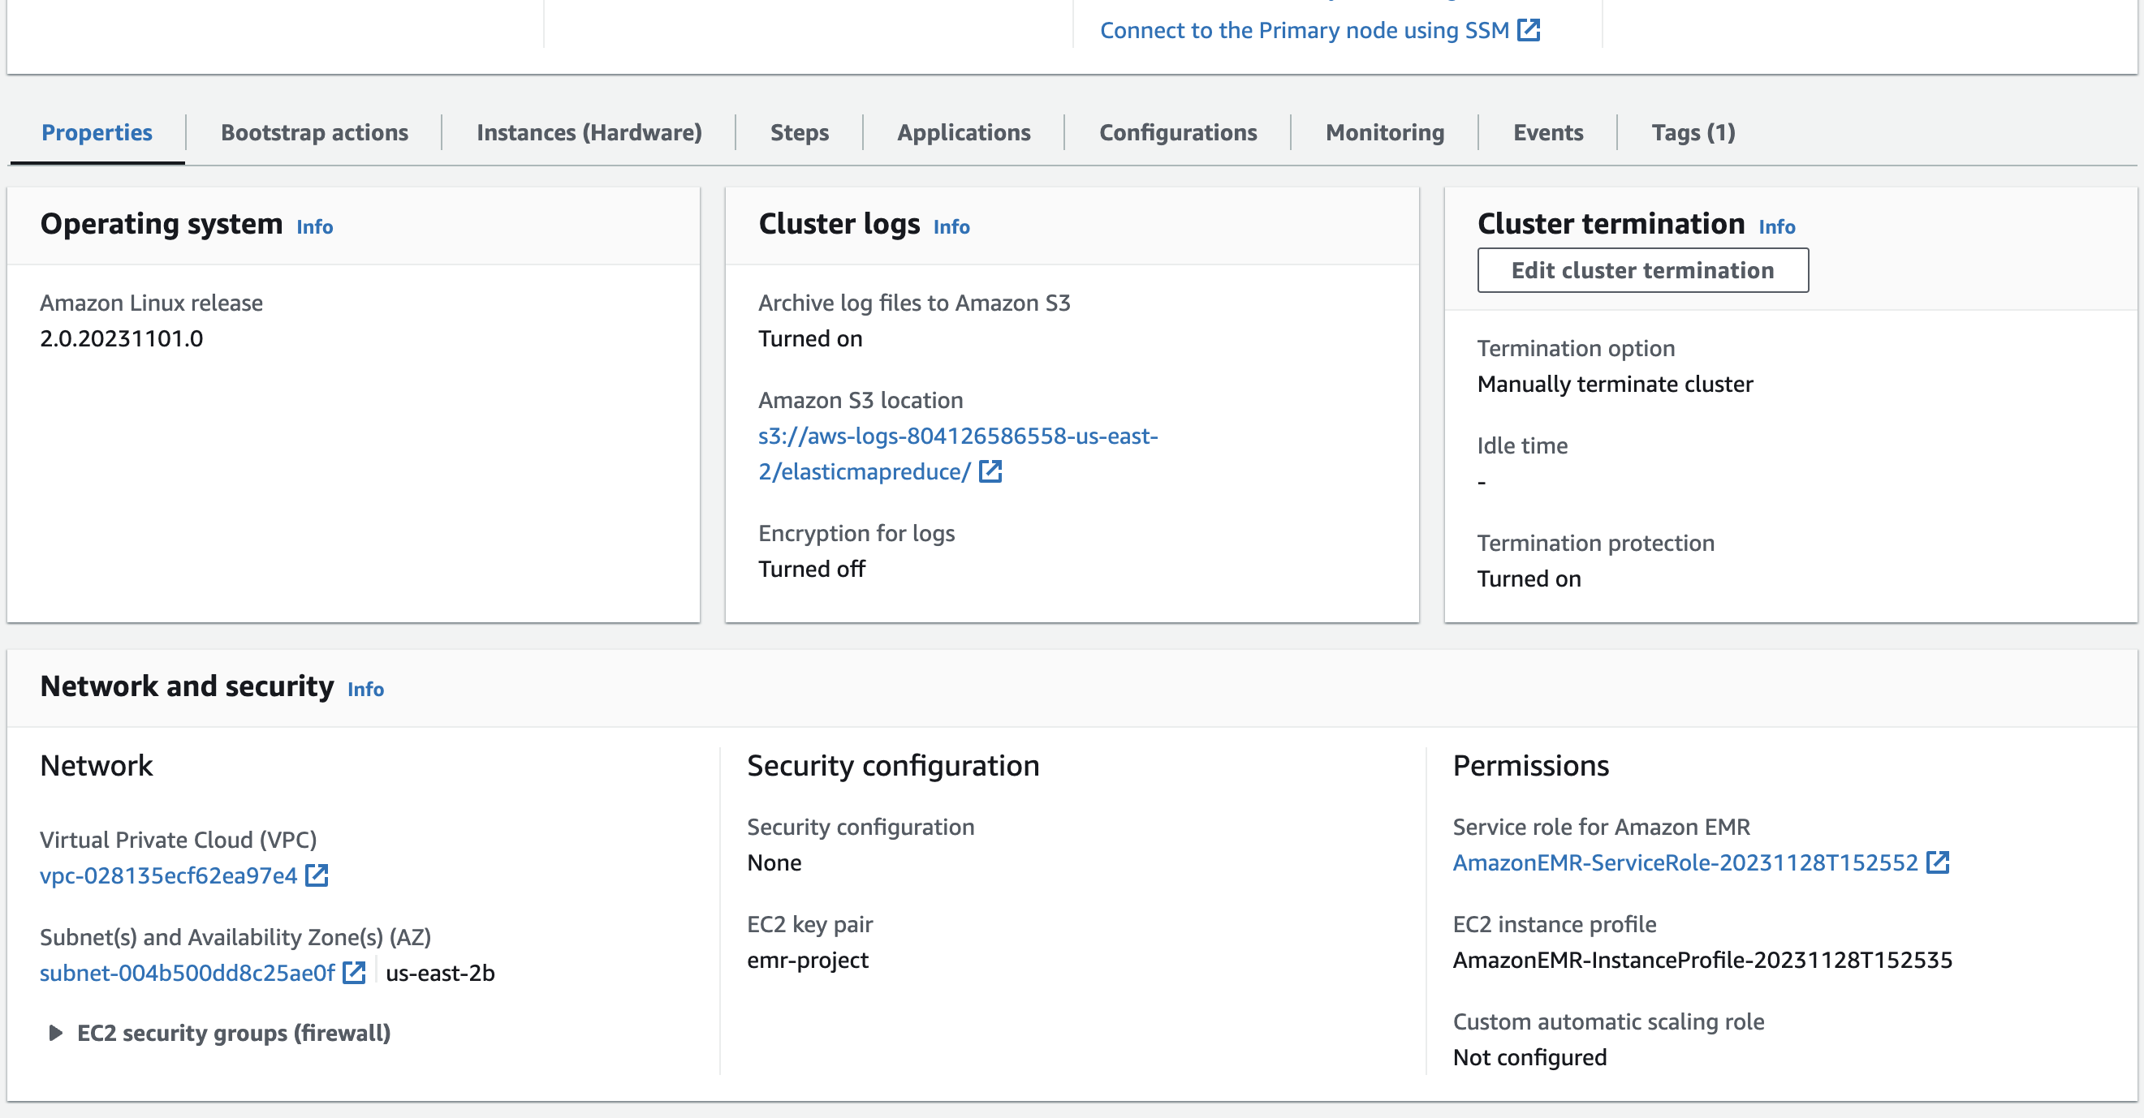
#ADD THE PICTURES IN THE next 4 to 5 SLIDES TOO AND
WRITE A ONE-LINE EXPLANATION ABOUT IT #

Slide 12
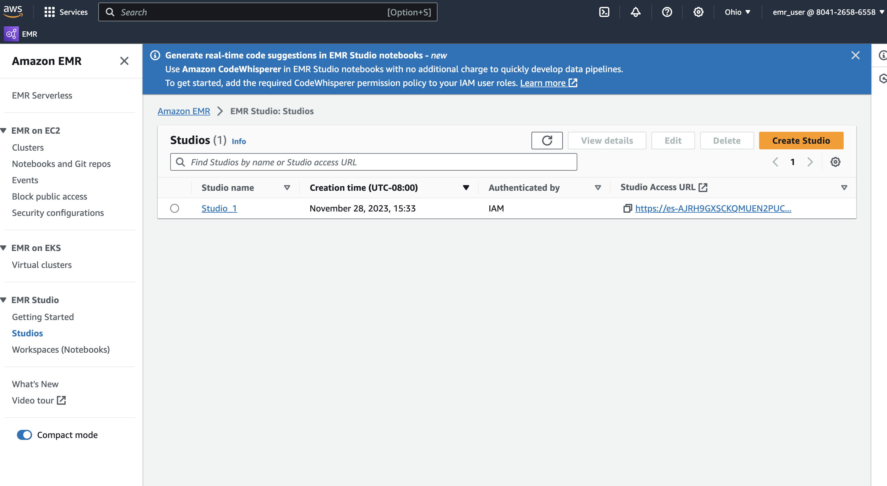
EMR STUDIO

Slide 13
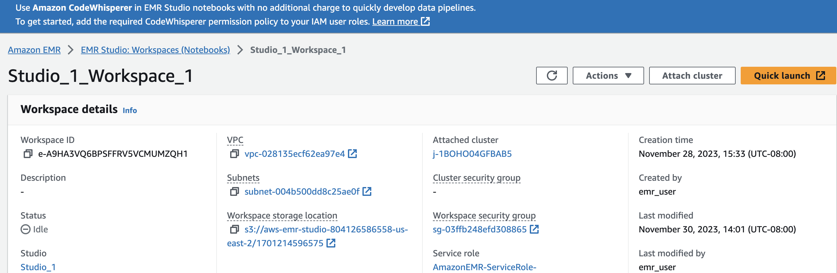
EMR WORKSPACE

Slide 14
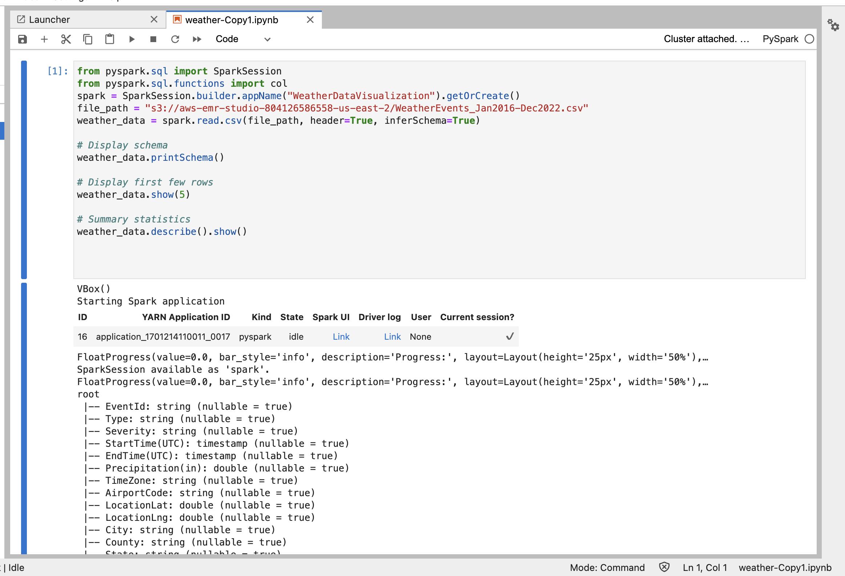
Spark Session

Slide 15
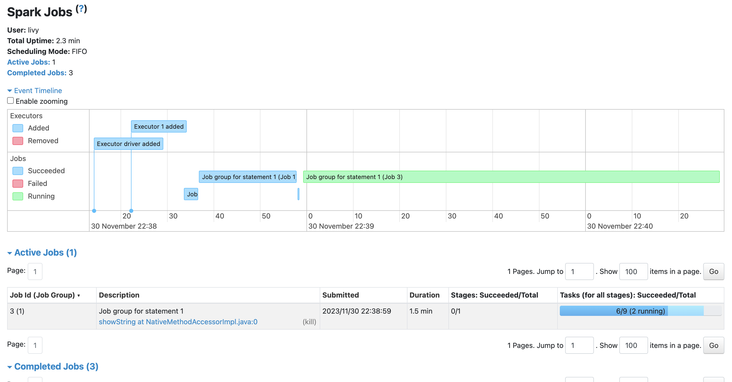

Slide 16
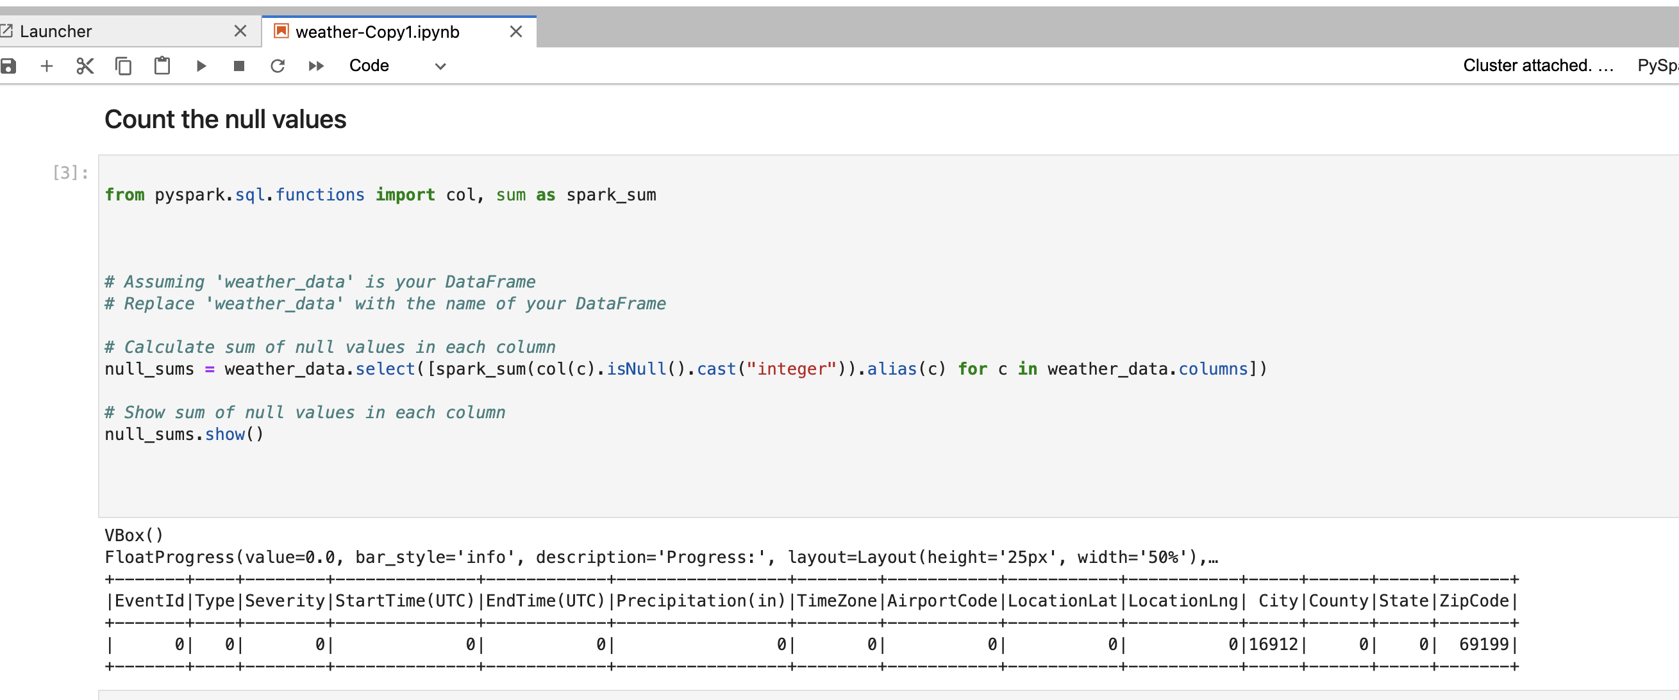
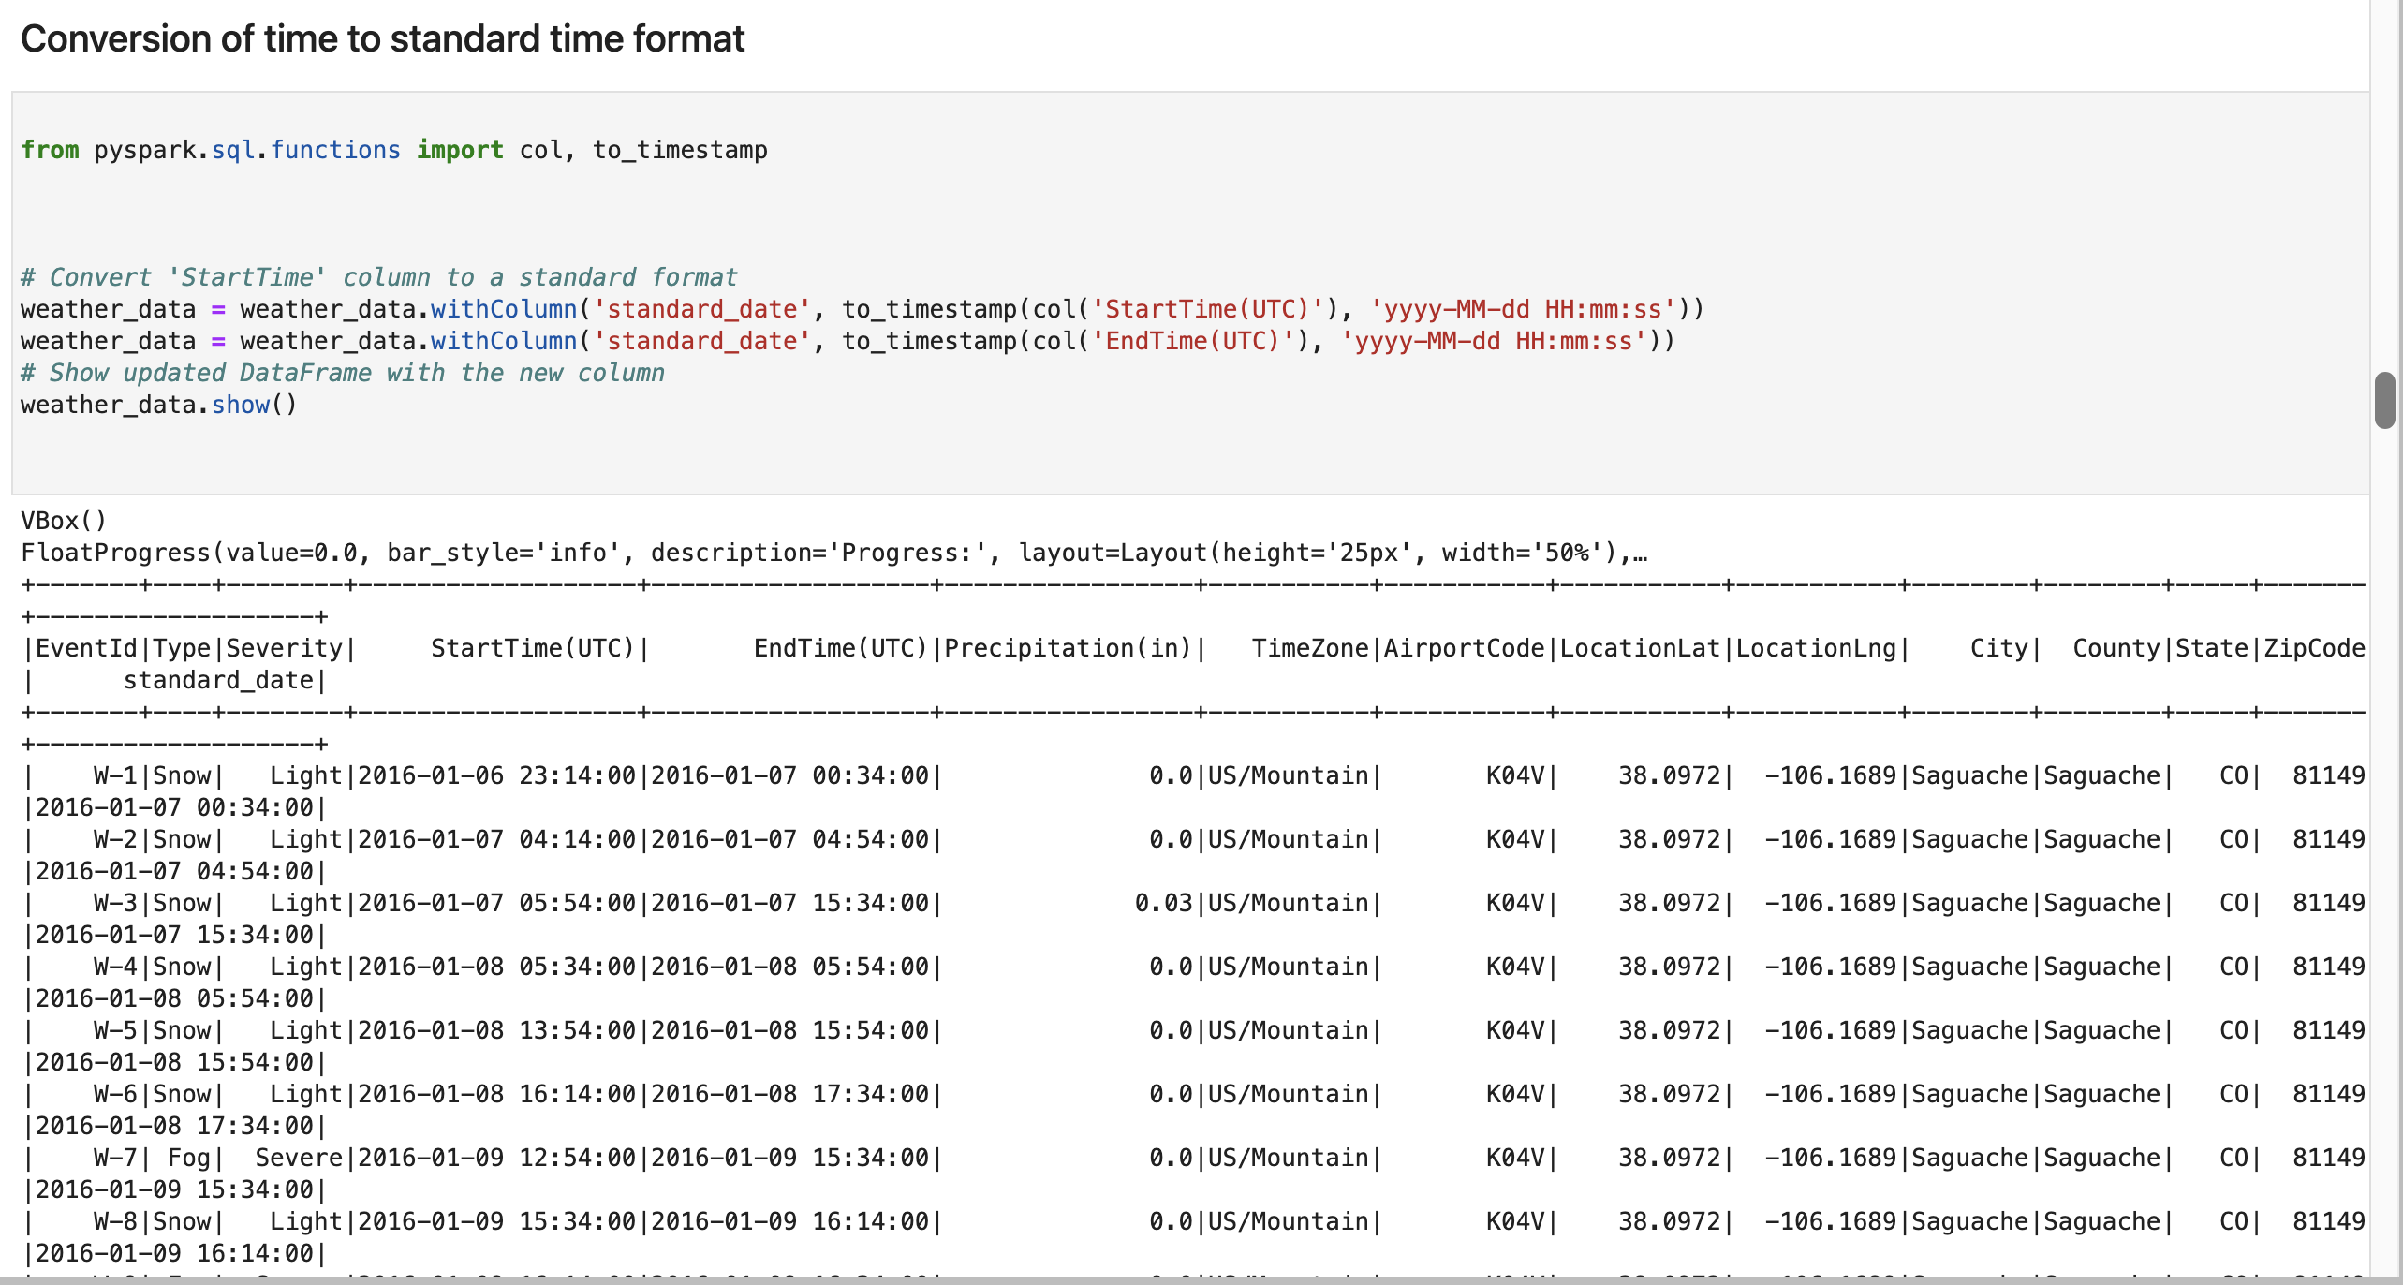
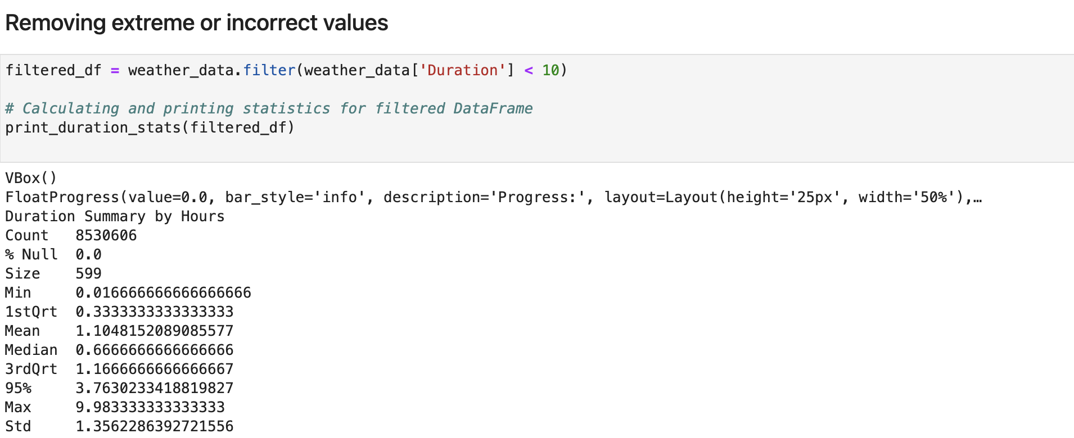
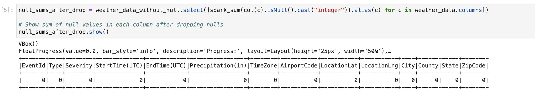
Data preprocessing

Slide 17
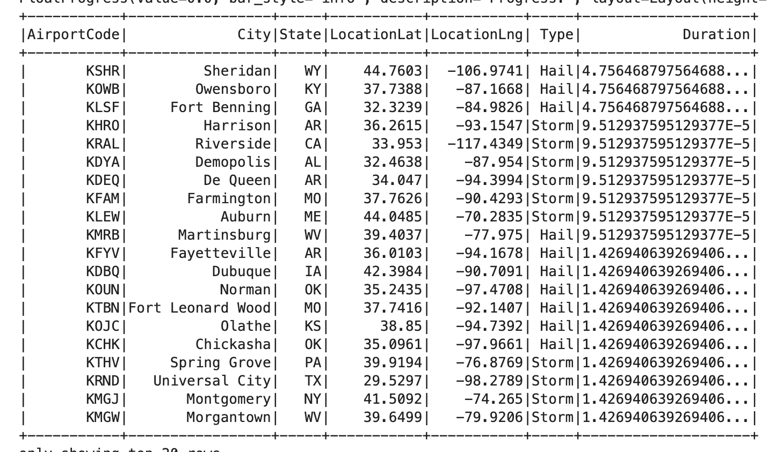
Data Visualization
PLOTLY
MATPLOTLIB

Slide 18
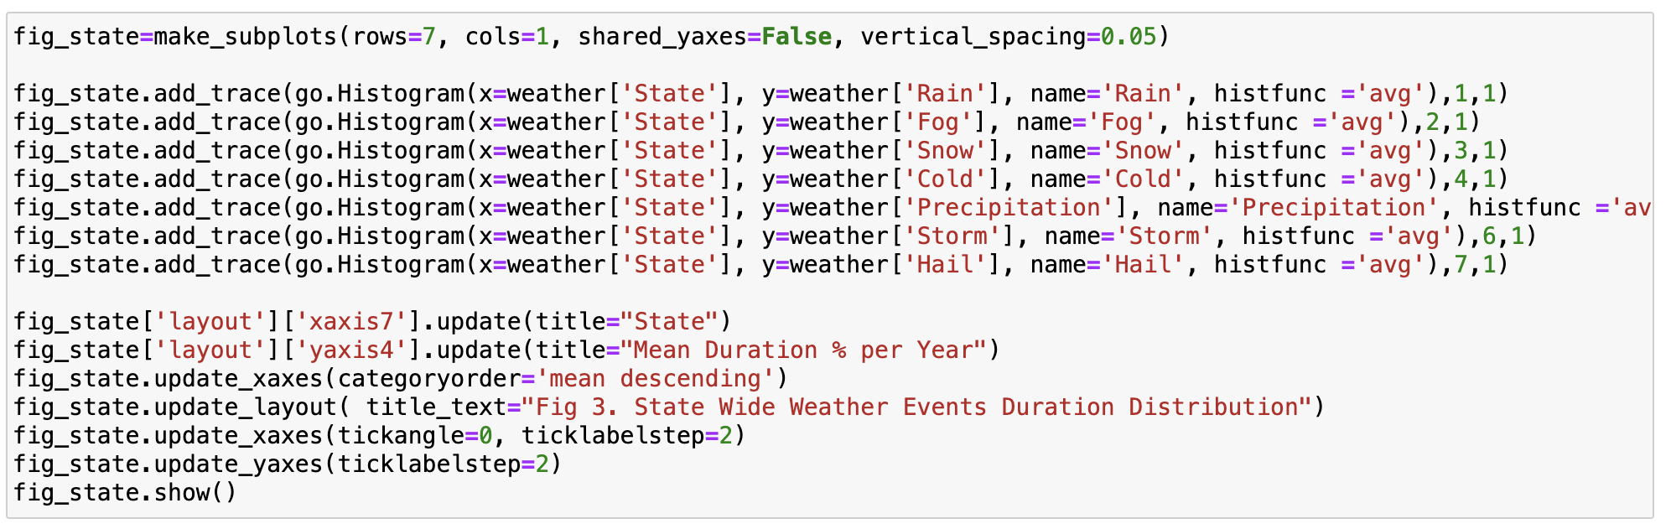
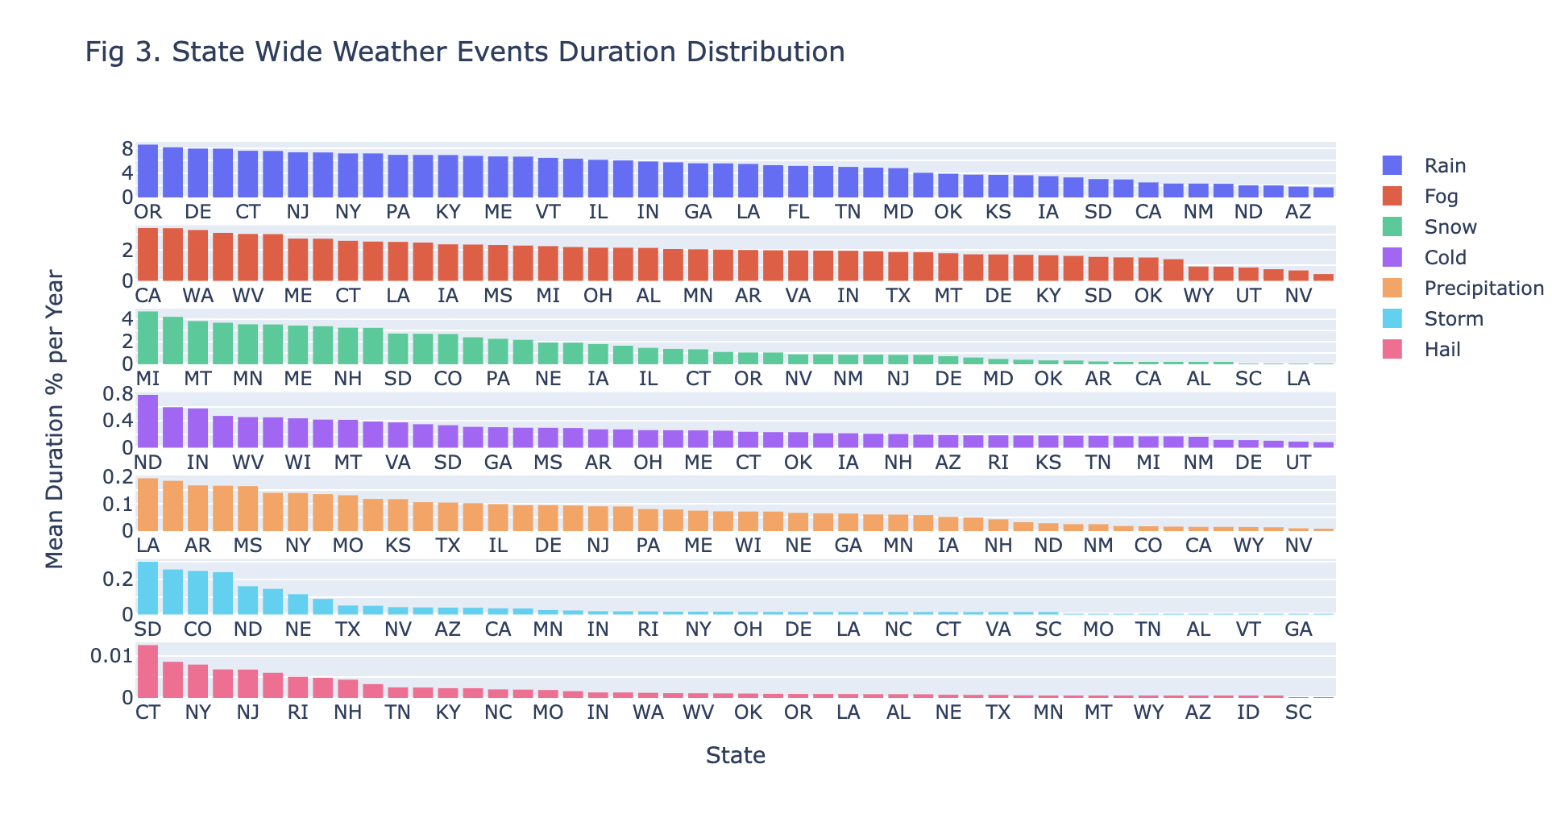
State and City wide Distribution
State

Slide 19
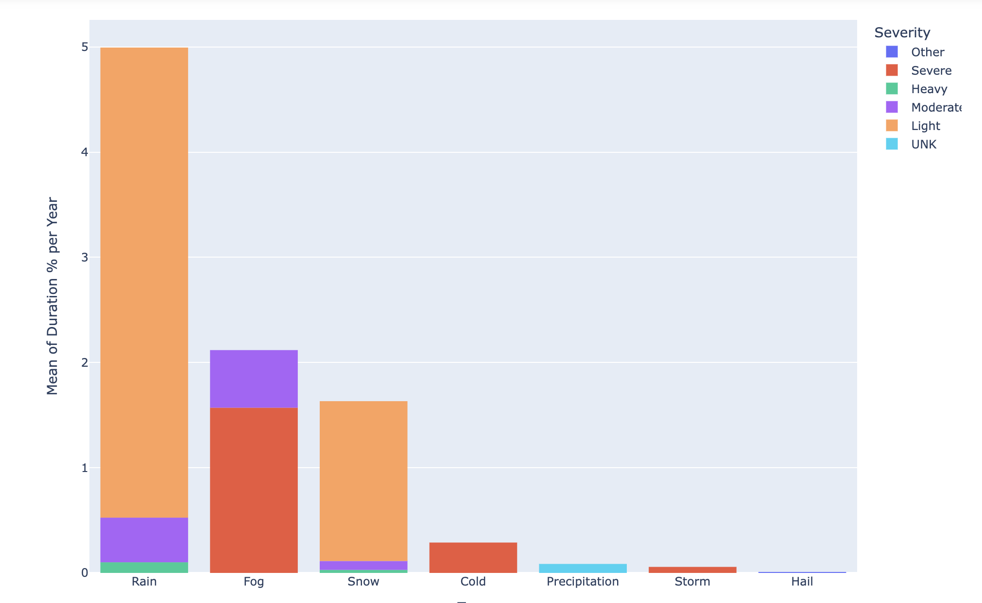
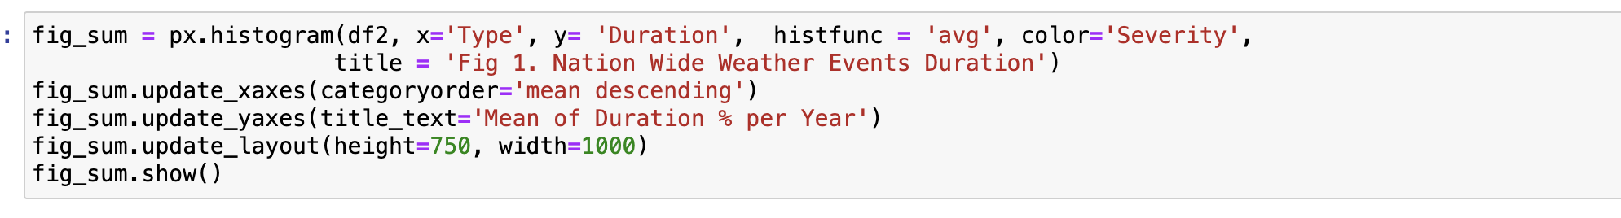
Yearly Distribution

Slide 20

ML Model Training and Evaluation
Pyspark ML Library is used for model training
Our model is classification model.

Slide 21
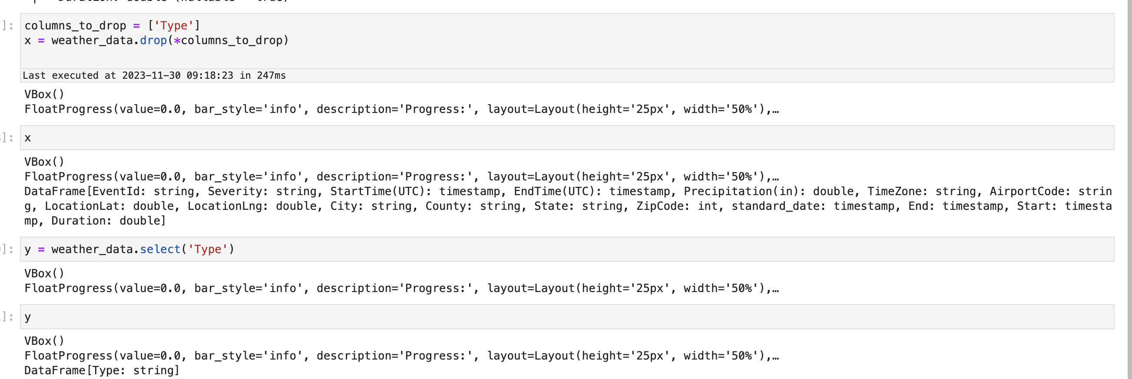
Train test Split

Slide 22
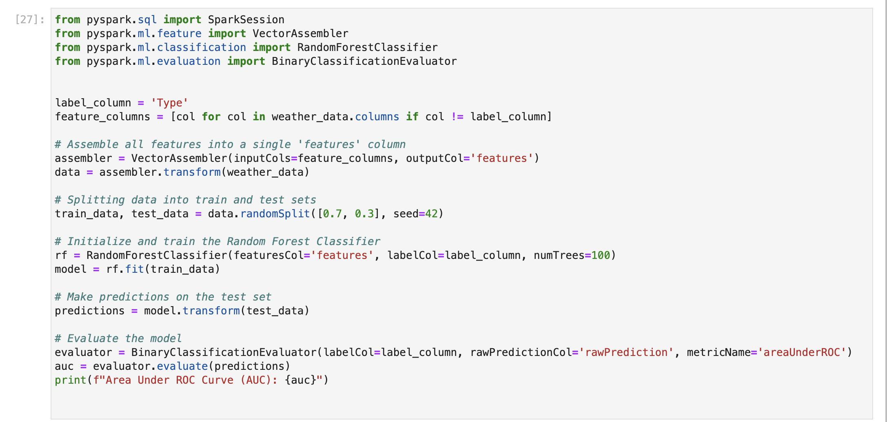
Random Forest Classifier

Slide 23

Thank you

